Slide 1
Artificial Neural Network
The term "Artificial neural network" refers to a biologically inspired sub-field of artificial intelligence modeled after the brain. An Artificial neural network is usually a computational network based on biological neural networks that construct the structure of the human brain. Similar to a human brain has neurons interconnected to each other, artificial neural networks also have neurons that are linked to each other in various layers of the networks. These neurons are known as nodes.

Slide 2
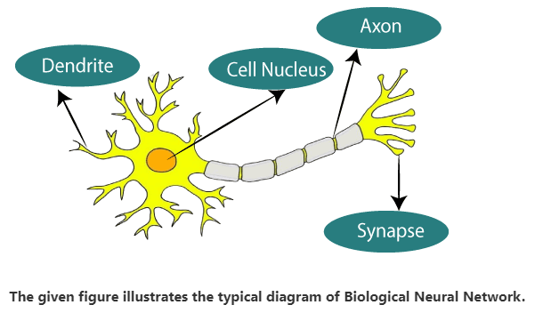
What is Artificial Neural Network?
The term "Artificial Neural Network" is derived from Biological neural networks that develop the structure of a human brain.
Similar to the human brain that has neurons interconnected to one another, artificial neural networks also have neurons that are interconnected to one another in various layers of the networks.
These neurons are known as nodes.

Slide 3
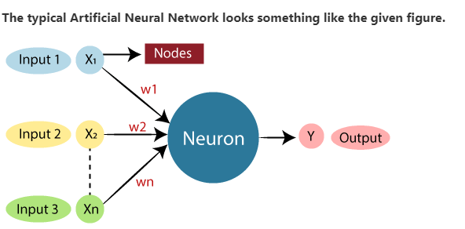
Dendrites from Biological Neural Network represent inputs in Artificial Neural Networks, cell nucleus represents Nodes, synapse represents Weights, and Axon represents Output.

Slide 4
Relationship between Biological neural network and artificial neural network:
Biological Neural Network | Artificial Neural Network
Dendrites | Inputs
Cell nucleus | Nodes
Synapse | Weights
Axon | Output

Slide 5
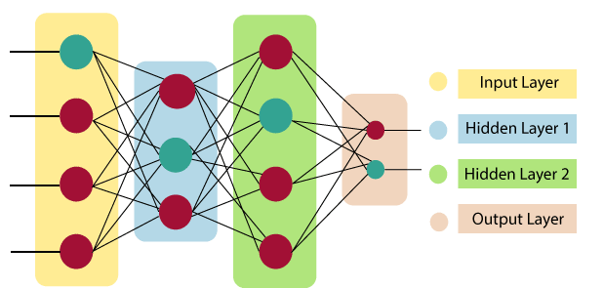
The architecture of an artificial neural network:
To understand the concept of the architecture of an artificial neural network, we have to understand what a neural network consists of. In order to define a neural network that consists of a large number of artificial neurons, which are termed units arranged in a sequence of layers. Lets us look at various types of layers available in an artificial neural network. Artificial Neural Network primarily consists of three layers:

Slide 6

Input Layer:
As the name suggests, it accepts inputs in several different formats provided by the programmer.
Hidden Layer:
The hidden layer presents in-between input and output layers. It performs all the calculations to find hidden features and patterns.
Output Layer:
The input goes through a series of transformations using the hidden layer, which finally results in output that is conveyed using this layer.
The artificial neural network takes input and computes the weighted sum of the inputs and includes a bias. This computation is represented in the form of a transfer function.
It determines weighted total is passed as an input to an activation function to produce the output. Activation functions choose whether a node should fire or not. Only those who are fired make it to the output layer. There are distinctive activation functions available that can be applied upon the sort of task we are performing.

Slide 7
What is the role of the bias in neural networks?
The bias term in neural networks serves as an additional parameter alongside the weights associated with each input feature. It represents the constant offset or shift in the activation of neurons, allowing the model to capture patterns that cannot be represented solely by the input features.
Here's a more detailed explanation of the role of bias in neural networks:
Introducing Flexibility: The bias term provides flexibility to the neural network by allowing it to fit more complex patterns in the data. Without bias, the decision boundary represented by the neural network would always pass through the origin, severely limiting the model's expressiveness.

Slide 8
Capturing Non-linear Relationships: In many real-world datasets, the relationship between input features and the target variable is non-linear. The bias term enables the neural network to capture these non-linear relationships by shifting the decision boundary in the activation function space.
Compensating for Imbalance: In situations where the input features have an inherent bias or where the classes in the dataset are imbalanced, the bias term helps compensate for these biases, ensuring that the neural network can still learn an appropriate decision boundary.
Improving Model Performance: Including bias in the neural network architecture improves its performance by allowing it to better fit the training data and generalize to unseen data. It helps prevent underfitting by enabling the model to learn the correct offset or shift needed to accurately predict the target variable.
Enhancing Model Robustness: Bias contributes to the robustness of the neural network by providing an additional degree of freedom during training. It helps the model adapt to variations and noise in the data, making it more resilient to overfitting and improving its performance on unseen data.

Slide 9
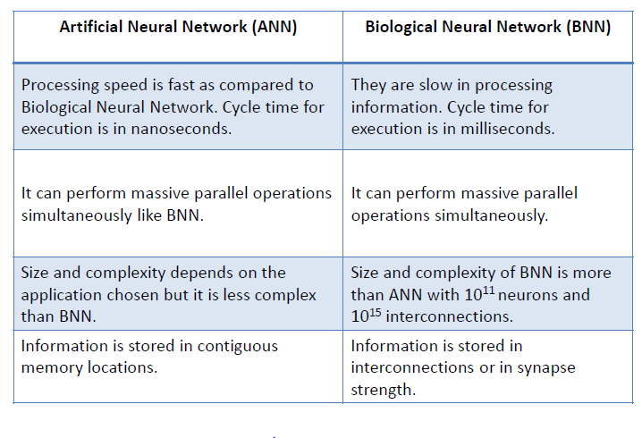
BNN v/s ANN

Slide 10
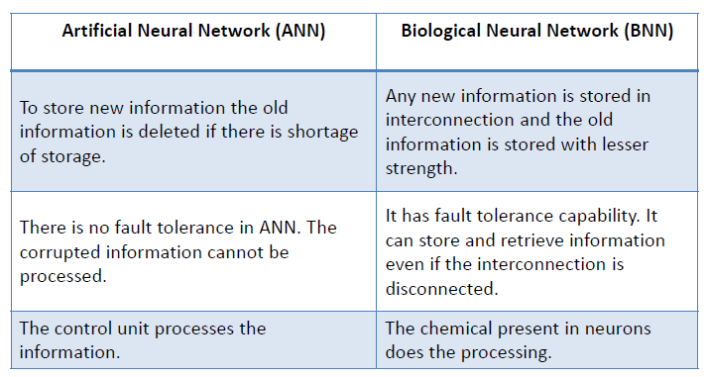
BNN v/s ANN

Slide 11
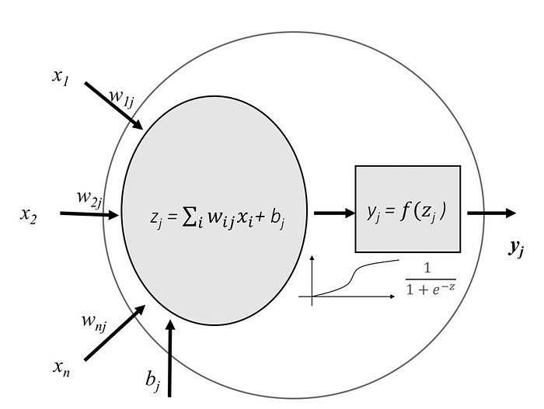
Learning process of a neural network
A neural network is made up of neurons connected to each other; at the same time, each connection of our neural network is associated with a weight that dictates the importance of this relationship in the neuron when multiplied by the input value.

Slide 12
Activation function
What is an Activation Function?
An activation function is a mathematical function applied to the output of a neuron. It introduces non-linearity into the model, allowing the network to learn and represent complex patterns in the data. Without this non-linearity feature, a neural network would behave like a linear regression model, no matter how many layers it has.
Activation function decides whether a neuron should be activated by calculating the weighted sum of inputs and adding a bias term. This helps the model make complex decisions and predictions by introducing non-linearities to the output of each neuron.

Slide 13
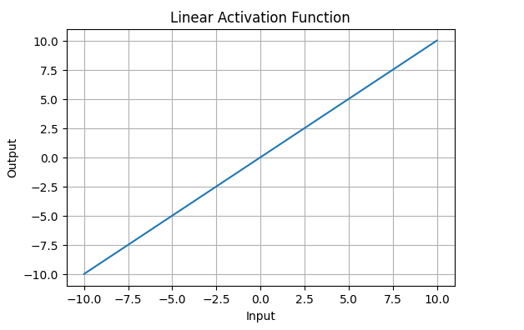
Different types of activation functions
Linear Activation Function resembles straight line define by y=x. No matter how many layers the neural network contains, if they all use linear activation functions, the output is a linear combination of the input.

Slide 14
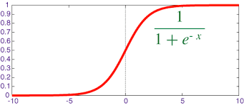
Non-Linear Activation Functions
Sigmoid Function:
The Sigmoid Activation Function is characterized by ‘S’ shape. This formula ensures a smooth and continuous output that is essential for gradient-based optimization methods.
It allows neural networks to handle and model complex patterns that linear equations cannot.
The output ranges between 0 and 1, hence useful for binary classification.

Slide 15

Tanh (bipolar sigmoid) function

Slide 16
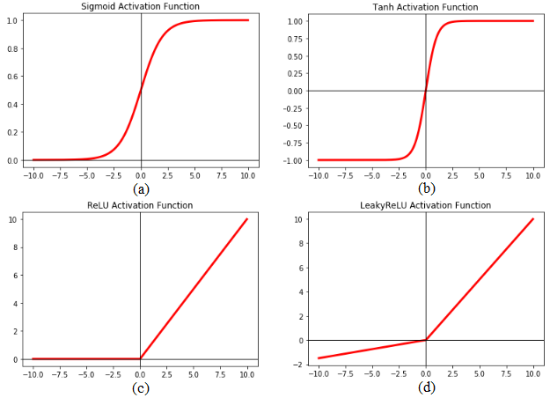

Slide 17



Slide 18


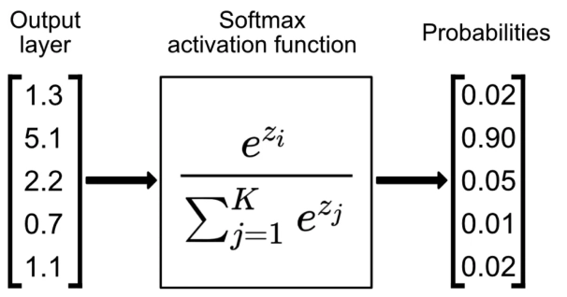

Slide 19
Learning process of a neural network
Training the neural network, that is, learning the values of our parameters (weights wij and bj biases) is the most genuine part of Deep Learning.
Learning process in a neural network as an iterative process of “going and return” by the layers of neurons.
The “going” is a forward propagation of the information and the “return” is a backpropagation of the information.

Slide 20
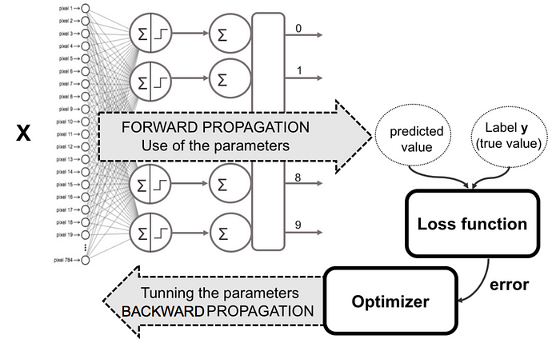
Learning process of a neural network
The first phase forward propagation occurs when the network is exposed to the training data and these cross the entire neural network for their predictions (labels) to be calculated.
That is, passing the input data through the network in such a way that all the neurons apply their transformation to the information they receive from the neurons of the previous layer and sending it to the neurons of the next layer.
When the data has crossed all the layers, and all its neurons have made their calculations, the final layer will be reached with a result of label prediction for those input examples.

Slide 21
Learning process of a neural network
Next, a loss function is used to estimate the loss (or error) and to compare and measure how good/bad the prediction result was in relation to the correct result (remember that we are in a supervised learning environment and we have the label that tells us the expected value).
Therefore, as the model is being trained, the weights of the interconnections of the neurons will gradually be adjusted until good predictions are obtained.

Slide 22
Learning process of a neural network
Once the loss has been calculated, this information is propagated backwards. Hence, its name: backpropagation.
Starting from the output layer, that loss information propagates to all the neurons in the hidden layer that contribute directly to the output.
However, the neurons of the hidden layer only receive a fraction of the total signal of the loss, based on the relative contribution that each neuron has contributed to the original output.
This process is repeated, layer by layer, until all the neurons in the network have received a loss signal that describes their relative contribution to the total loss.

Slide 23
Backpropagation Process in Deep Neural Network
. Backpropagation is a supervised learning algorithm, for training Multi-layer Perceptrons (Artificial Neural Networks). For a single training example, Backpropagation algorithm calculates the gradient of the error function. Backpropagation can be written as a function of the neural network. Backpropagation algorithms are a set of methods used to efficiently train artificial neural networks following a gradient descent approach which exploits the chain rule.
The main features of Backpropagation are the iterative, recursive and efficient method through which it calculates the updated weight to improve the network until it is not able to perform the task for which it is being trained. Derivatives of the activation function to be known at network design time is required to Backpropagation

Slide 24
Learning process of a neural network
Now that we have spread this information back, we can adjust the weights of connections between neurons. What we are doing is making the loss as close as possible to zero the next time we go back to using the network for a prediction.
For this, we will use a technique called gradient descent.
This technique changes the weights in small increments with the help of the calculation of the derivative (or gradient) of the loss function, which allows us to see in which direction “to descend” towards the global minimum; this is done in general in batches of data in the successive iterations (epochs) of all the dataset that we pass to the network in each iteration.

Slide 25
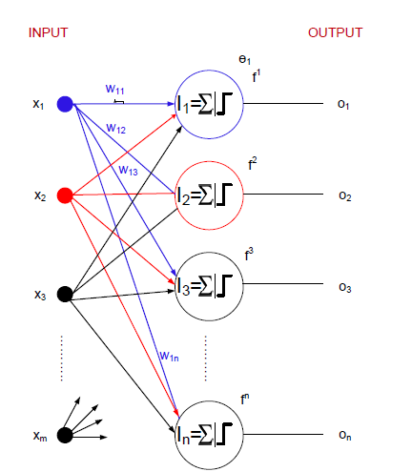
Single layer feed forward neural network
The concept of the AND problem and its solution with a single neuron can be extended to multiple neurons.

Slide 26
Single layer feed forward neural network
We see, a layer of n neurons constitutes a single layer feed forward neural network.
This is so called because, it contains a single layer of artificial neurons.
Note that the input layer and output layer, which receive input signals and transmit output signals are although called layers, they are actually boundary of the architecture and hence truly not layers.
The only layer in the architecture is the synaptic links carrying the weights connect every input to the output neurons.

Slide 27
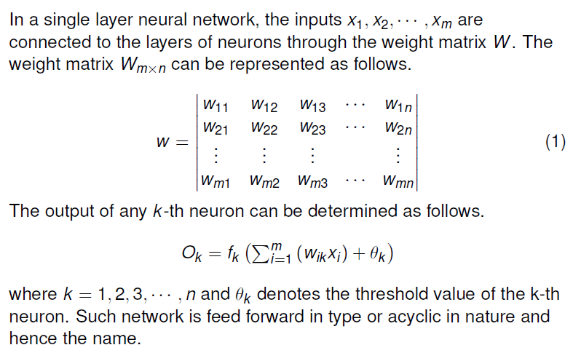
Modelling SLFFNN

Slide 28
Multilayer feed forward neural networks
This network, as its name indicates is made up of multiple layers.
Thus architectures of this class besides processing an input and an output layer also have one or more intermediary layers called hidden layers.
The hidden layer(s) aid in performing useful intermediary computation before directing the input to the output layer.
A multilayer feed forward network with l input neurons (number of neuron at the first layer), m1;m2;…;mp number of neurons at i-th hidden layer (i = 1; 2;…; p) and n neurons at the last layer (it is the output neurons) is written as l –m1-m2-…-mp-n MLFFNN.

Slide 29
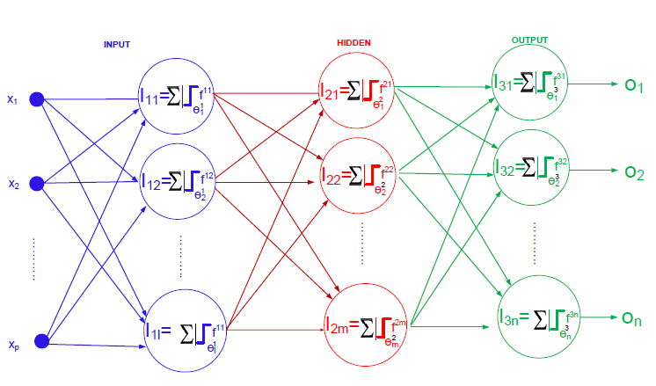
Multilayer feed forward neural networks
Figure shows a schematic diagram of multilayer feed forward neural network with a configuration of l-m-n.

Slide 30
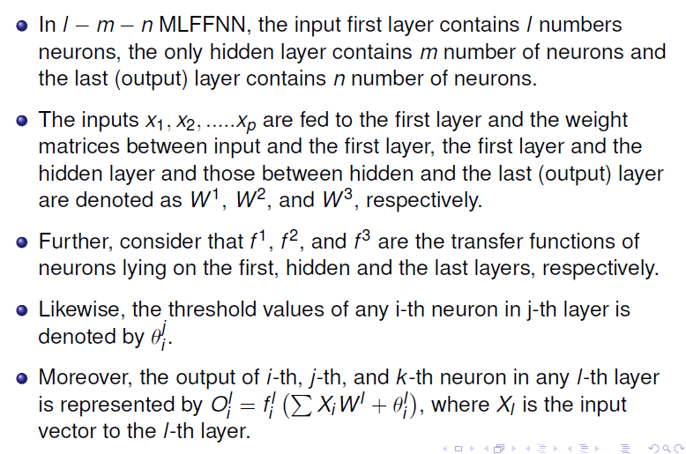
Multilayer feed forward neural networks

Slide 31
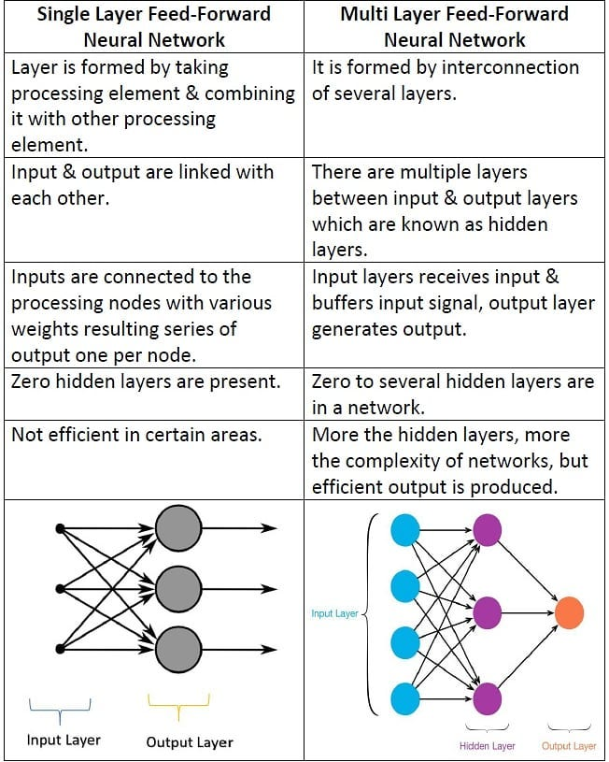

Slide 32
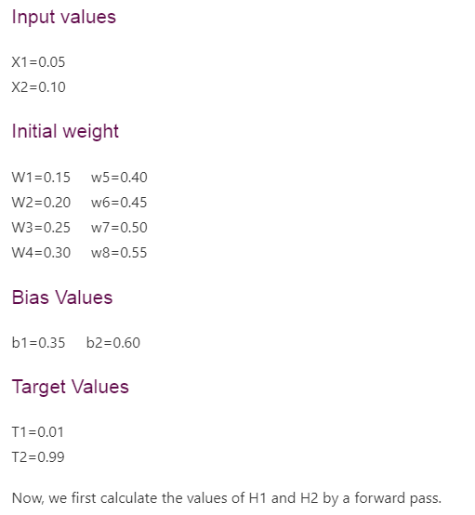
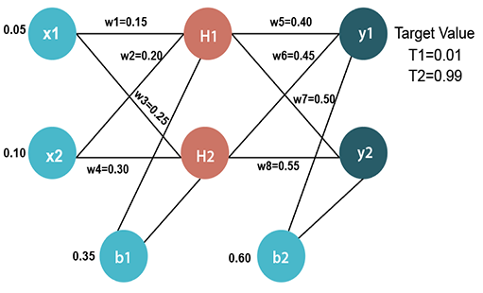
How error function is used in Backpropagation and how Backpropagation works?

Slide 33
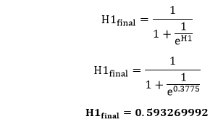
Forward Pass
To find the value of H1 we first multiply the input value from the weights as
H1=x1×w₁+x2×w₂+b1 H1=0.05×0.15+0.10×0.20+0.35 H1=0.3775
To calculate the final result of H1, we performed the sigmoid function as

Slide 34
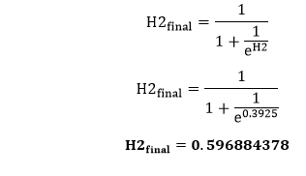
We will calculate the value of H2 in the same way as H1
H2=x1×w₃+x2×w₄+b1 H2=0.05×0.25+0.10×0.30+0.35
H2=0.3925
To calculate the final result of H2, we performed the sigmoid function as
To calculate the final result of H1, we performed the sigmoid function as
y1=H1×w₅+H2×w₆+b2 y1=0.593269992×0.40+0.596884378×0.45+0.60 y1=1.10590597

Slide 35
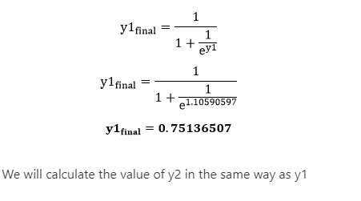
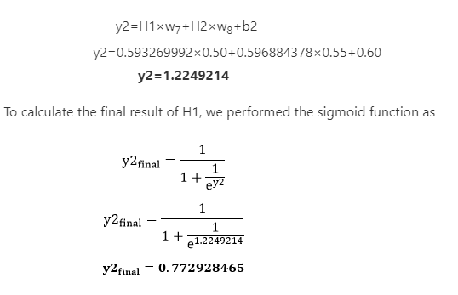
To calculate the final result of y1 we performed the sigmoid function as

Slide 36
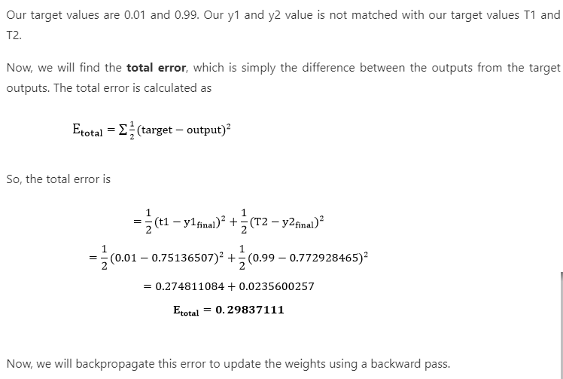

Slide 37



Backward pass at the output layer
To update the weight, we calculate the error correspond to each weight with the help of a total error. The error on weight w is calculated by differentiating total error with respect to w.
We perform backward process so first consider the last weight w5 as
From equation two, it is clear that we cannot partially differentiate it with respect to w5 because there is no any w5. We split equation one into multiple terms so that we can easily differentiate it with respect to w5 as

Slide 38
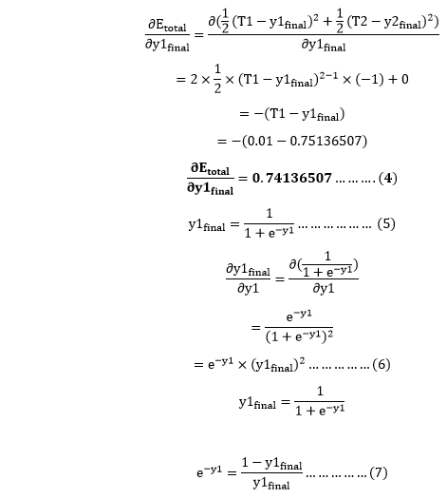
Now, we calculate each term one by one to differentiate E_{total} with respect to w5 as

Slide 39
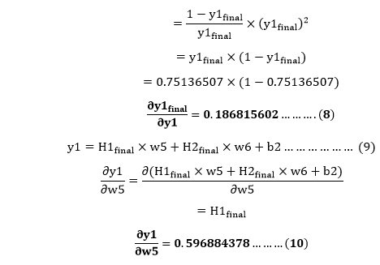
Putting the value of e^{-y} in equation (5)

Slide 40

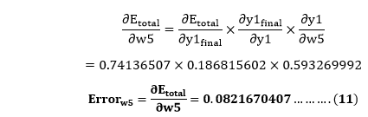
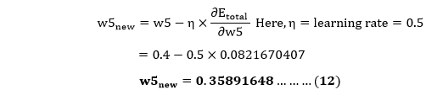
So, we put the values of in equation no (3) to find the final result.
Now, we will calculate the updated weight w5_{new} with the help of the following formula

Slide 41
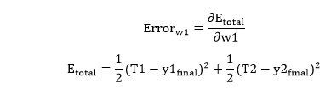
In the same way, we calculate w6_{new},w7_{new}, and w8_{new} and this will give us the following values
w5_{new}=0.35891648 w6_{new}=408666186 w7_{new}=0.511301270 w8_{new}=0.561370121
Backward pass at Hidden layer
Now, we will backpropagate to our hidden layer and update the weight w1, w2, w3, and w4 as we have done with w5, w6, w7, and w8 weights.
We will calculate the error at w1 as

Slide 42




From equation (2), it is clear that we cannot partially differentiate it with respect to w1 because there is no any w1. We split equation (1) into multiple terms so that we can easily differentiate it with respect to w1 as
Now, we calculate each term one by one to differentiate E_{total} with respect to w1 as
We again split this because there is no any H1^{final} term in E^{total} as
will again split because in E1 and E2 there is no H1 term. Splitting is done as

Slide 43
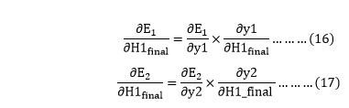

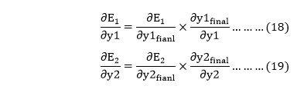

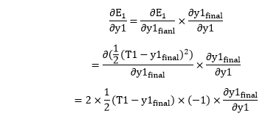
We again Split both because there is no any y1 and y2 term in E1 and E2. We split it as
Now, we find the value of by putting values in equation (18) and (19) as
From equation (18)

Slide 44

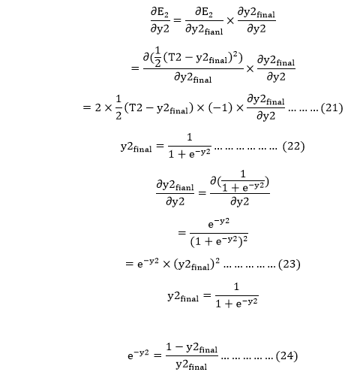
From equation (8)
From equation (19)

Slide 45
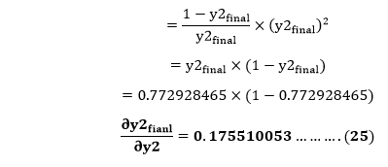

Putting the value of e^{-y2} in equation (23)
From equation (21)

Slide 46
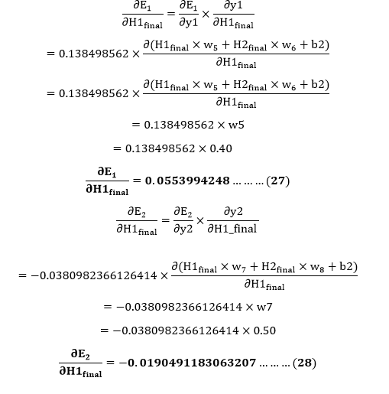
Now from equation (16) and (17)

Slide 47
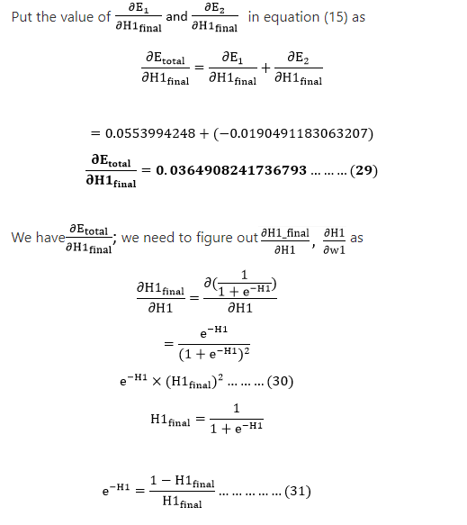

Slide 48
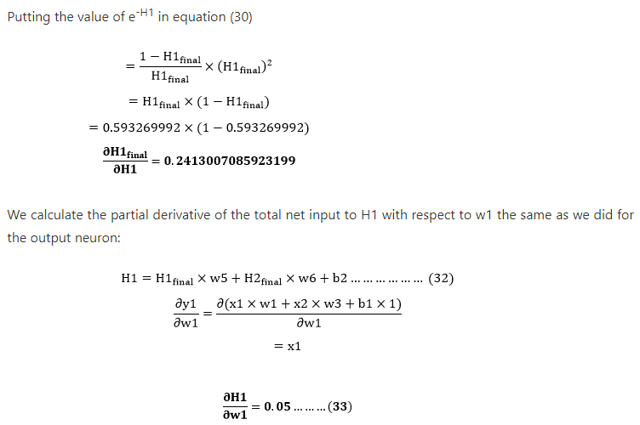

Slide 49
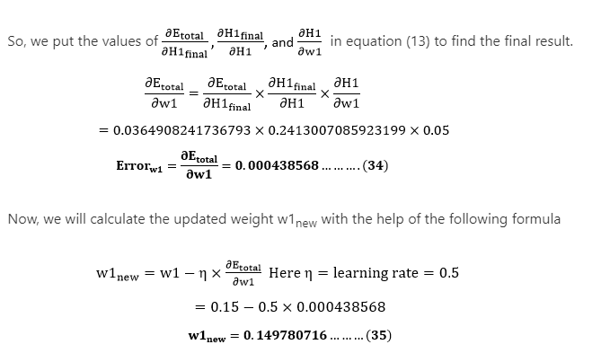

Slide 50
In the same way, we calculate w2_{new},w3_{new}, and w4 and this will give us the following values
w1_{new}=0.149780716 w2_{new}=0.19956143 w3_{new}=0.24975114 w4_{new}=0.29950229
We have updated all the weights. We found the error 0.298371109 on the network when we fed forward the 0.05 and 0.1 inputs. In the first round of Backpropagation, the total error is down to 0.291027924. After repeating this process 10,000, the total error is down to 0.0000351085. At this point, the outputs neurons generate 0.159121960 and 0.984065734 i.e., nearby our target value when we feed forward the 0.05 and 0.1.

Slide 51
What is the Perceptron model in Machine Learning?
Perceptron is Machine Learning algorithm for supervised learning of various binary classification tasks. Further, Perceptron is also understood as an Artificial Neuron or neural network unit that helps to detect certain input data computations in business intelligence.
Perceptron model is also treated as one of the best and simplest types of Artificial Neural networks. However, it is a supervised learning algorithm of binary classifiers. Hence, we can consider it as a single-layer neural network with four main parameters, i.e., input values, weights and Bias, net sum, and an activation function.

Slide 52
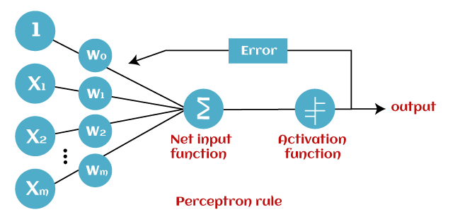
How does Perceptron work?
In Machine Learning, Perceptron is considered as a single-layer neural network that consists of four main parameters named input values (Input nodes), weights and Bias, net sum, and an activation function. The perceptron model begins with the multiplication of all input values and their weights, then adds these values together to create the weighted sum. Then this weighted sum is applied to the activation function 'f' to obtain the desired output. This activation function is also known as the step function and is represented by 'f'.

Slide 53
Types of Perceptron Models
Based on the layers, Perceptron models are divided into two types. These are as follows:
Single-layer Perceptron Model
The main objective of the single-layer perceptron model is to analyze the linearly separable objects with binary outcomes.
A single-layered perceptron model consists feed-forward network
2.Multi-layer Perceptron model
The multi-layer perceptron model is also known as the Backpropagation algorithm, which executes in two stages as follows:
Forward Stage: Activation functions start from the input layer in the forward stage and terminate on the output layer.
Backward Stage: In the backward stage, weight and bias values are modified as per the model's requirement. In this stage, the error between actual output and demanded originated backward on the output layer and ended on the input layer.

